Slide 1
Contemporary Music & World Music
Kenny Lim

Slide 2
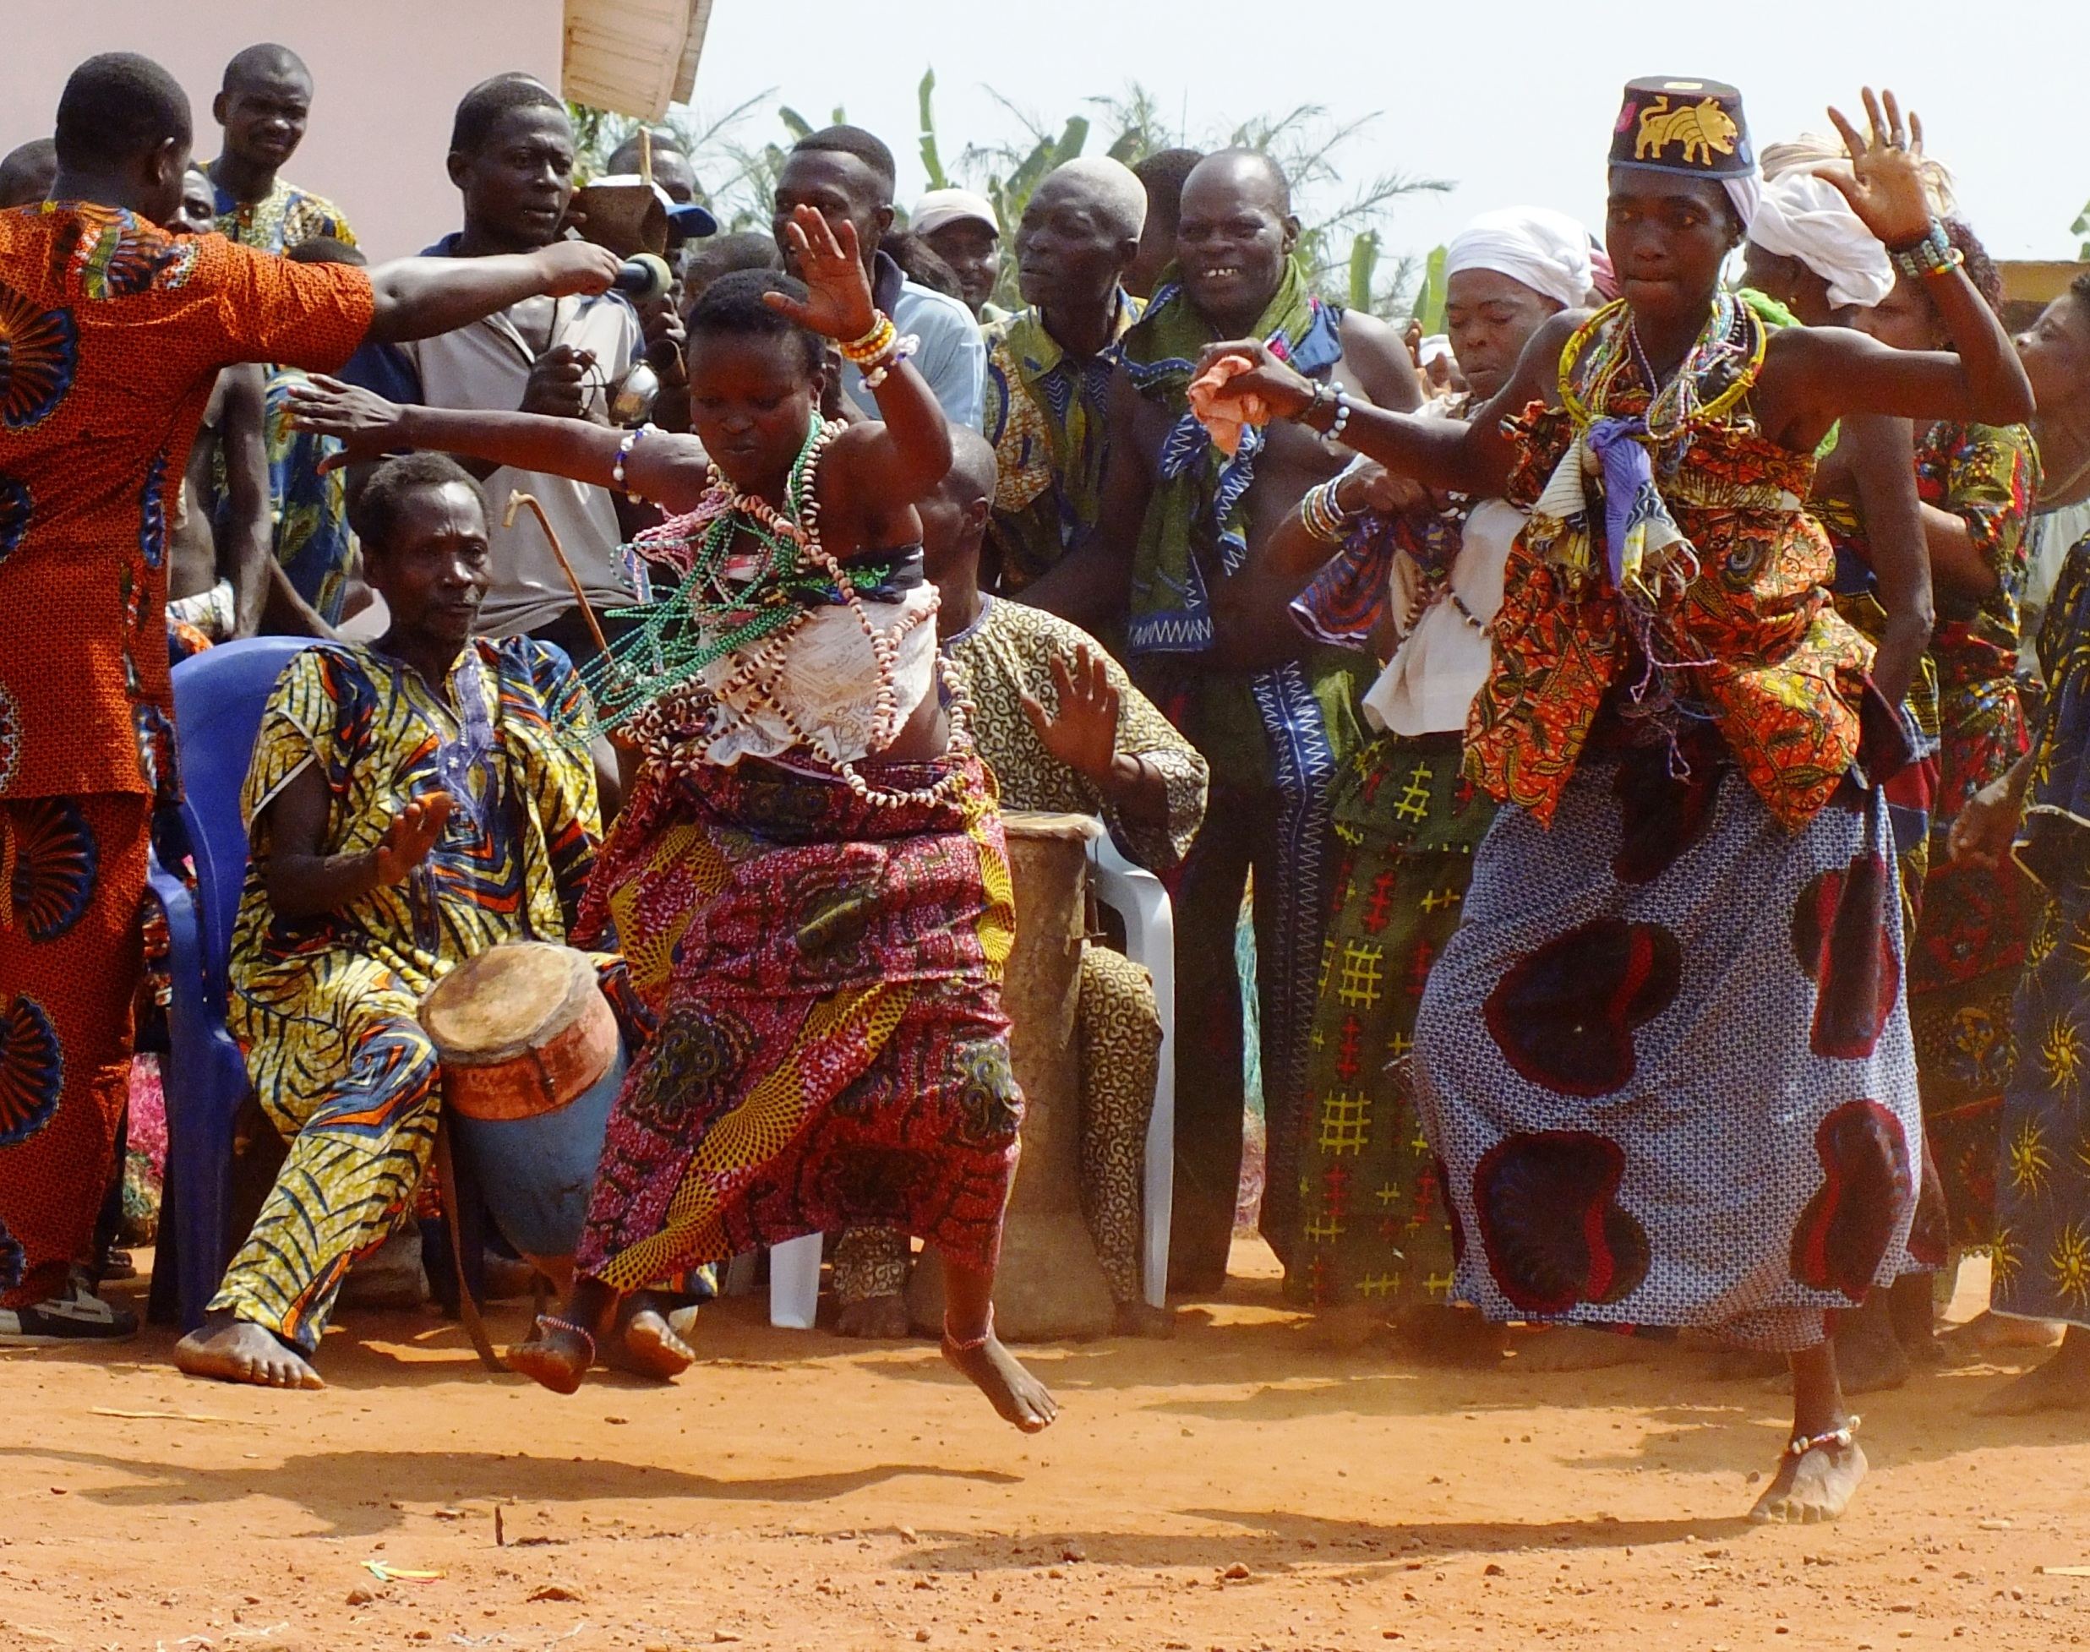
Non-western music
African Music
Indian Music
Japan Music

Slide 3
Music served as:
Entertainment
Accompaniment to everyday activities, ceremony
Communicate message
People tradition
Wide range of Musical style

Slide 4
Characteristics
Oral Tradition: Transmitted orally from parent to child or from teacher to student. Music notation is less important in nonwestern culture.
Improvisation: important in nonwestern musical cultures.
Voices: Widely used in various ways.

Slide 5
Four categories of instruments:
Idiophones: Instruments that generate the sound from its own material with no tension applied e.g. bells, gongs, xylophone.
Chordophones: Sound generated by stretching strings. E.g. Harps and Lutes
Aerophones: Sound generated by column of air. E.g. Trumpets, flutes.
Membranophones: Sound generated by drums with stretched skin or other membranes.

Slide 6
Sub-Saharan African Music
Sub-Saharan Africa is culturally diverse, has several different religions, social customs and over 700 different languages.
Features complex rhythms and polyrhythms, percussive sounds and a wide variety of instrumental ensembles.
Musical cultures between different tribes also have influenced each other.
Music are highly embedded in to their daily lifestyle.
African music is closely associated with dancing
Intimately linked with language.

Slide 7
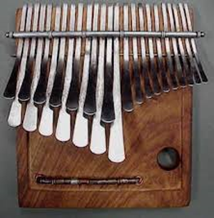
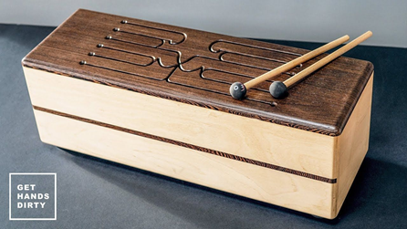
African instruments
Logdrum or Slit Drum
Mbira or Thumb piano

Slide 8
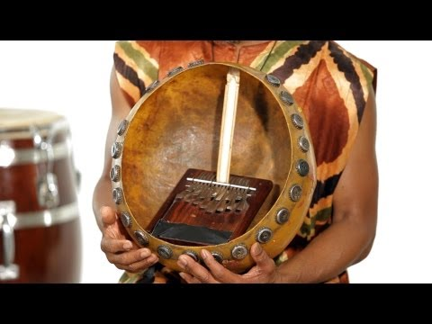

Slide 9
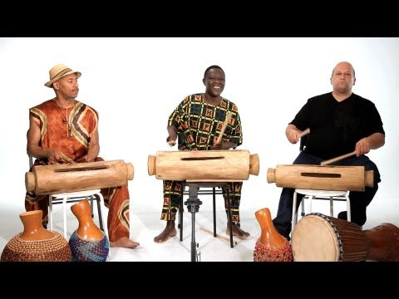

Slide 10


Slide 11
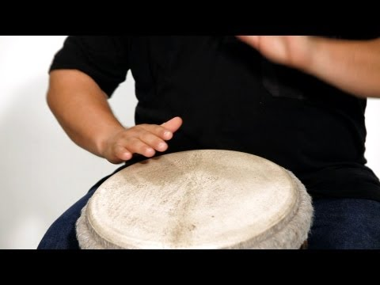
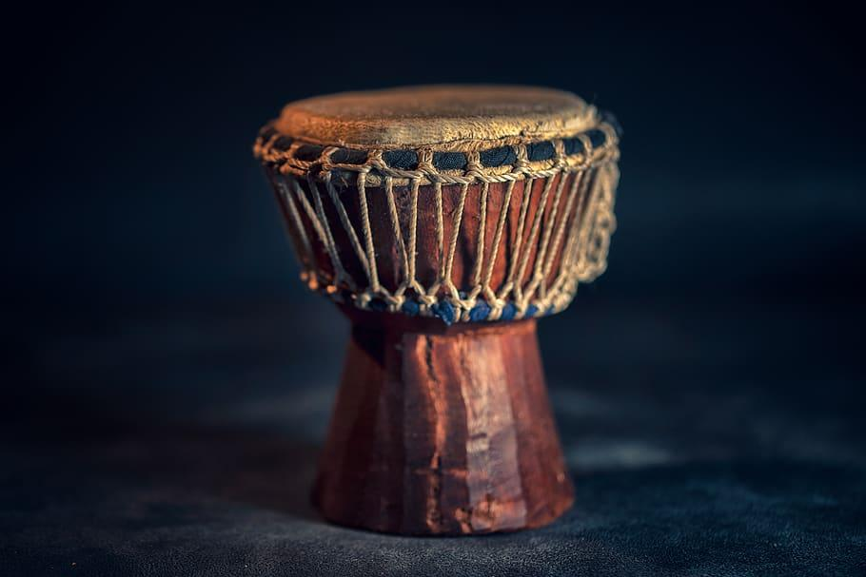
Djembe

Slide 12
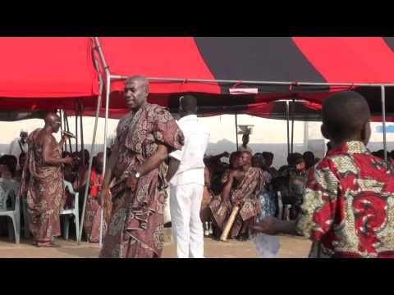

Slide 13
Classical music in India
Dated back for more than 3000 years, among one of the oldest music tradition in the world.
Two distinct traditions: Karnatak Music (South India); Hindustani Music (North India)
Notes:
North indian music were mainly performed in princely courts, while south indian music were mainly performed in temples.

Slide 14
Indian music performance practice
Consider their music spiritual in character
Musical traditions are transmitted orally from master to disciple, who learns by imitation, not by studying textbooks or written music
Improvisation has an important role
Generally performed by soloist and drummer
Indian music are based on the human voice
Melodies often move by microtones
Raga and Tala

Slide 15
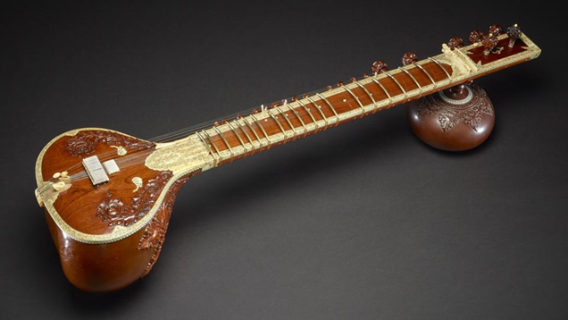
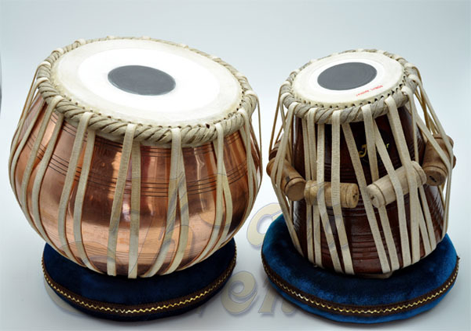
Sitar & Tabla
Sitar
Tabla

Slide 16
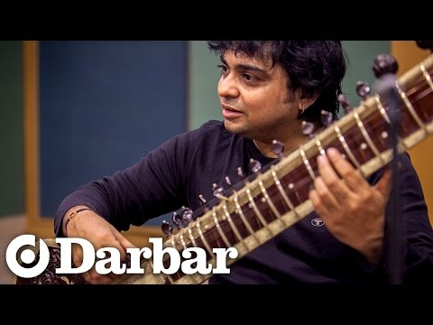
What is the raga?

Slide 17
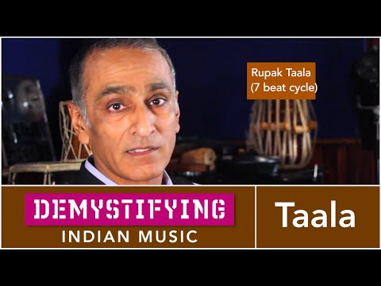
What is Tala?

Slide 18
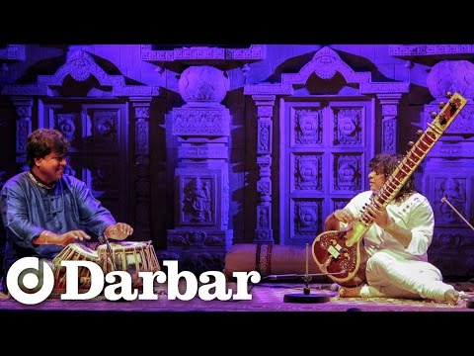

Slide 19
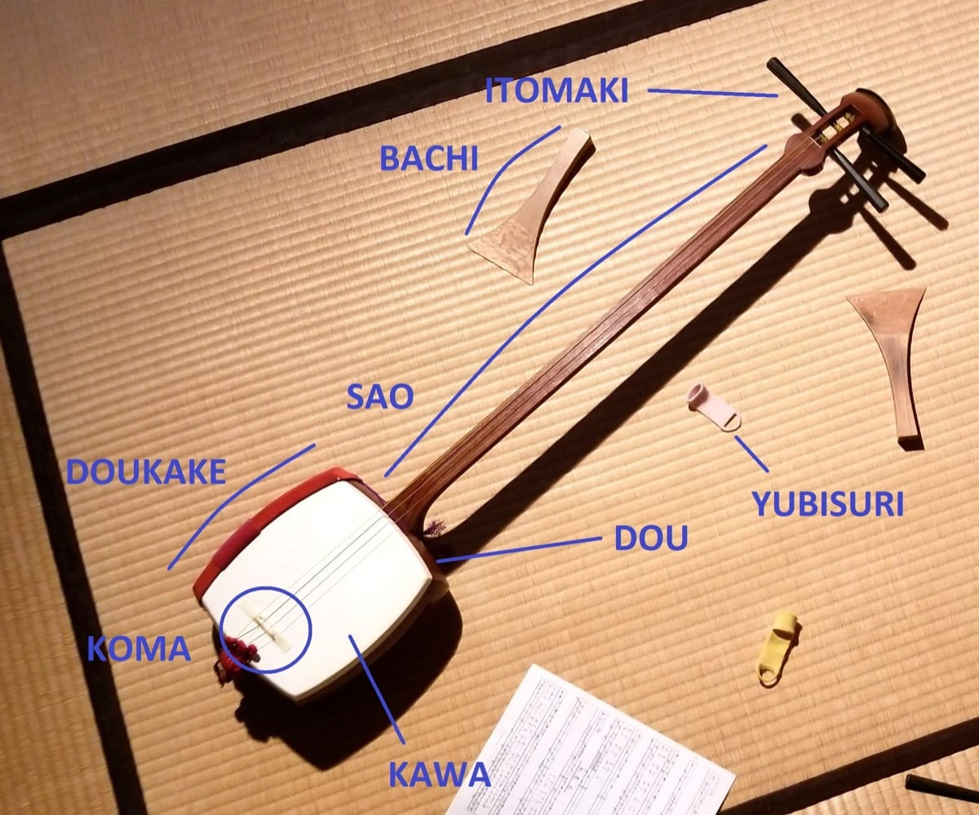
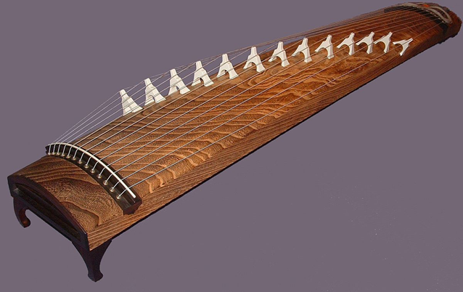
Japan Music
Koto
Shamisen
Notes:
The skin used depends on the genre of music and the skill of the player. Traditionally, skins were made using dog or cat skin, with cat skin favored for finer instruments
Silk or nylon string for shamisen
Koto 13 strings, Guzehgn 21

Slide 20
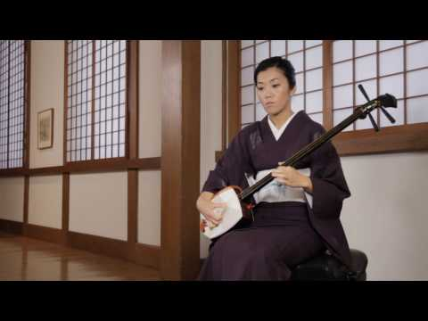

Slide 21
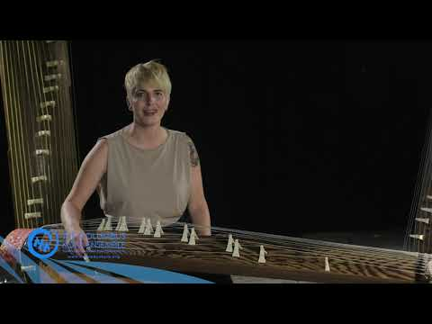

Slide 22
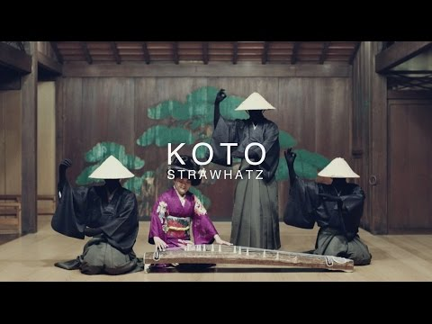

Slide 23
Musical Theatre
Type of American theatre to entertain through fusion of a dramatic script, acting and spoken dialogue with music, singing and dancing – and scenery, costumes and spectacle
Eg. West Side Story, Cats, My Fair Lady etc.
With verse and chorus ( A - A - B – A)
Most Musical Theatre plots are based off modern society backgrounds

Slide 24
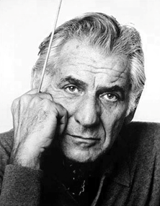
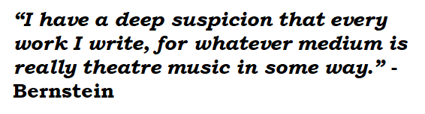
Leonard Bernstein (1918 - 1990)
Born in Lawrence, Massachusetts
A leading conductor, concert pianist, a composer and author-lecturer.

Slide 25
West side story
R & J | WSS
Two families | Jets and Sharks
Romeo | Tony
Juliet | Maria
Bernardo is the leader of the Sharks, the brother of Maria. In a gang fight, Tony Kills Bernardo in an attempt to break up a fight between the leader of the Sharks and Riff. Later Tony was shot by one of the Sharks and dies in Maria’s arms.

Slide 26
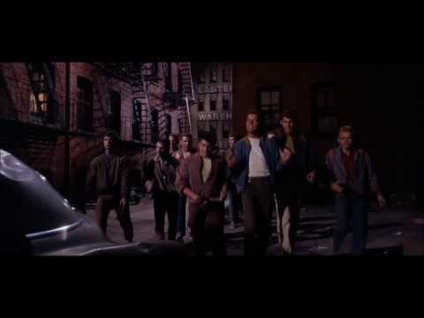

Slide 27
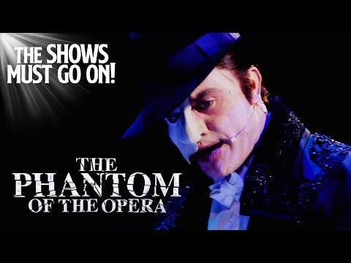
Phantom of the Opera - Andrew Llyod Weber

Slide 28
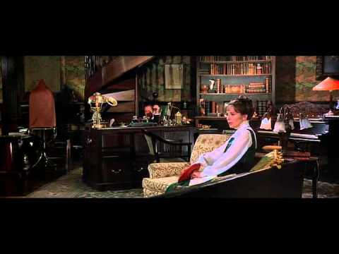
My Fair Lady (Adapted from Pygmalion by George Bernard Shaw)

Slide 29
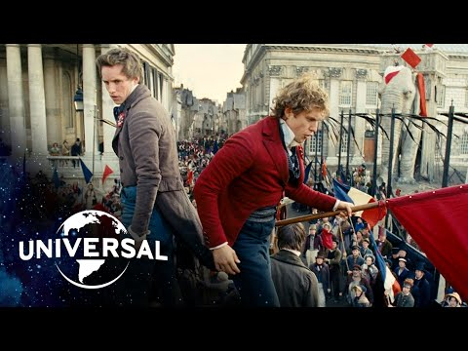
Les Miserable (Based on a novel by Victor Hugo, composer by Claude-Michel Shoenberg)

Slide 30
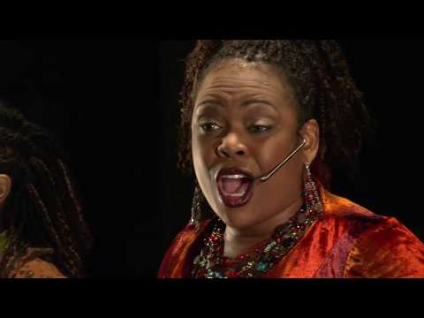
Rent Musical (Jonathan Larson)

Slide 31
Rock and Roll
Music with a hard, driving beat, often featuring electronic guitar accompaniment and heavily amplified
E.g. Elvis Presley, Bill Haley, Ray Charles etc.
Originate from R&B (Rhythm & Blues)
Fast rhythm and continued bass
Heavy beats on 2nd and 4th beat

Slide 32
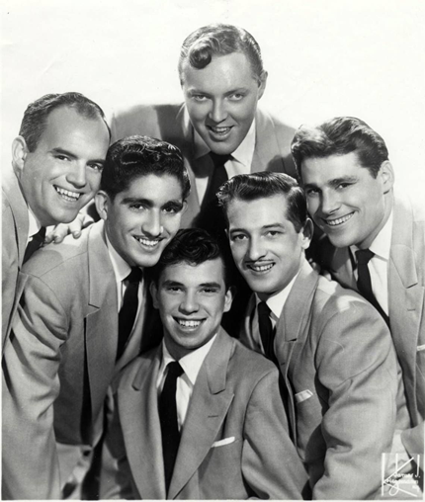
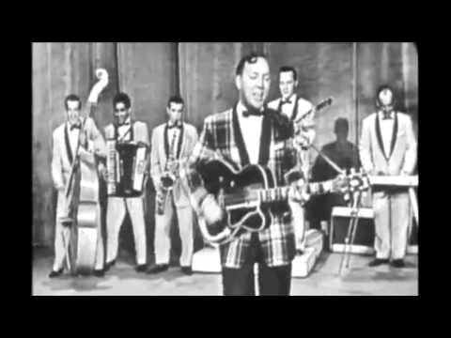
Bill Haley and His Comets

Slide 33
Late 1960s
1980s
1990s
Fusion, folk rock, jazz rock, psychedelic rock, acid rock, art rock … etc.
Renewed interest in Heavy Metal
Rap was invented
Heavy Metal developed more variety: thrash, speed metal and death metal
Public embraced the appearance of grunge or alternative rock

Slide 34
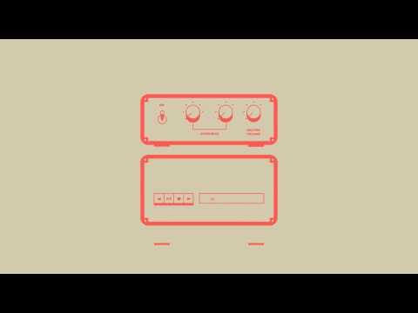

Slide 35
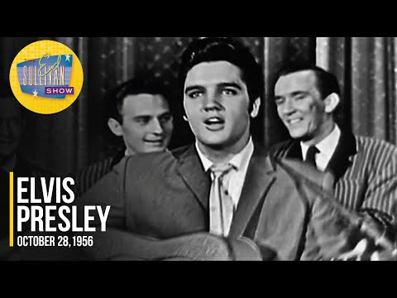
King of Rock & Roll (Elvis Presley)

Slide 36
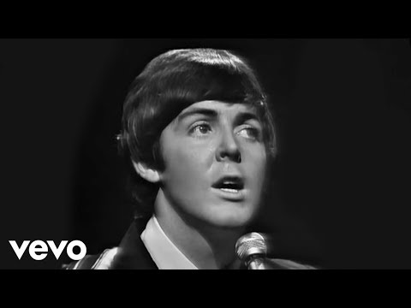
Yesterday (Beatles)

Slide 37
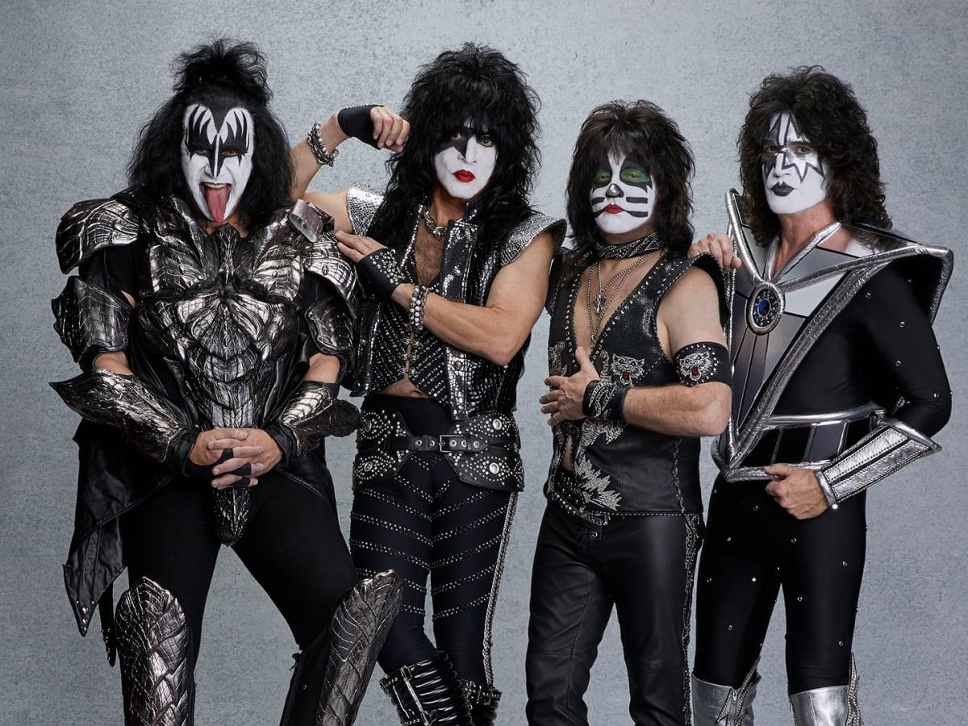
Popularity of Rock and Rock Persona
Rock music speaks to the young Americans/Europeans at the time.
Rock persona became a trend and this “tradition” can still be seen today in modern pop culture.

Slide 38
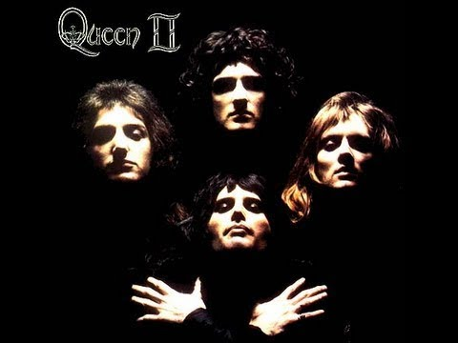
Bohemian Rhapsody (Queen)

Slide 39
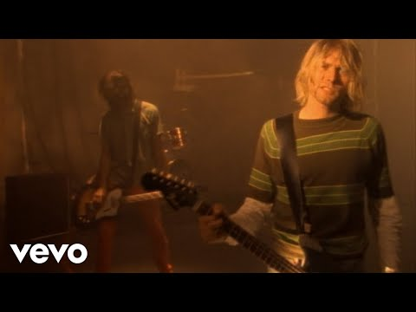
Grunge

Slide 40

Alternative Rock

Slide 41

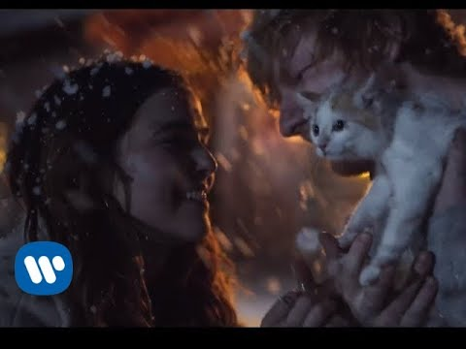
Sentimental Music
Slow and steady rhythm and normally about love
Melodic tune, easy to remember

Slide 42

Rap Music
Rhythm flows and without specific melody tunes
Originated by the Black Americans
The melody tends to be continuous and fast
Percussion instruments will support the rhythm

Slide 43
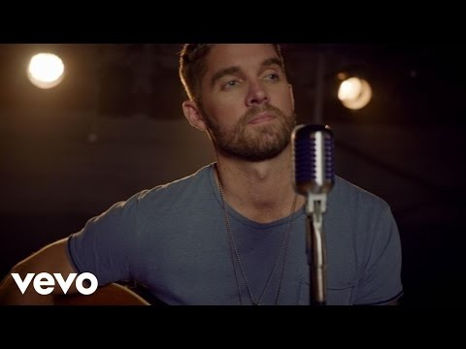
Folk Music
Music is calm = relaxed feeling
Lyrics are non formal and many reflect certain countryside environment, daily activities
With guitar accompaniment/ banjo/ washboard
The rhythm gently flows

Slide 44
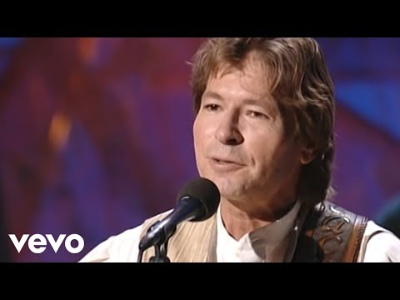

Slide 45


